Slide 1
Neural Network and Backpropagation
CSC 249/449 Spring 2019
http://www.cs.rochester.edu/~cxu22/t/249S19/
Instructor: Chenliang Xu
chenliang.xu@rochester.edu

Slide 2

Single Neuron
Biological Neuron

Slide 3

Single Neuron
Biological Neuron
Computational Neuron

Slide 4
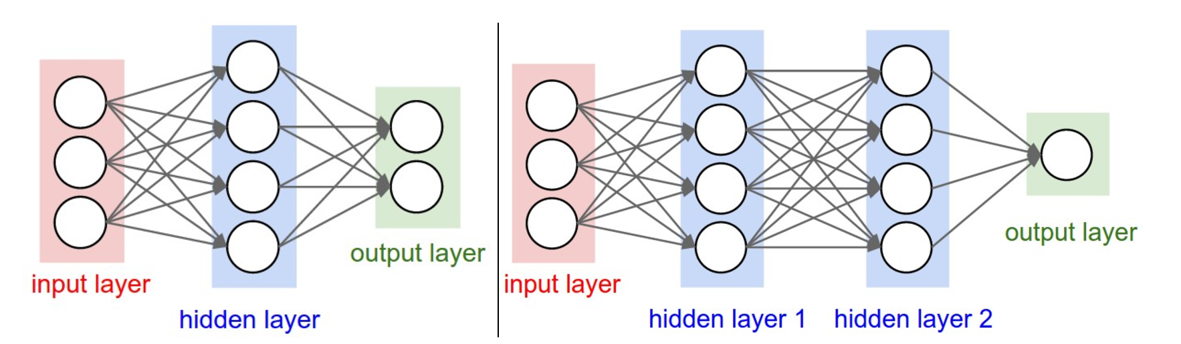
Neural Network Representation
Cascade Neurons together.
The output from one layer is the input to the next.
Each layer has its own sets of weights.
Credit: Fei-Fei Li & Andrej Karpathy & Justin Johnson

Slide 5
Neural Network Representation
How many neurons excluding input units?
4 + 2 = 6
4 + 4 + 1 = 9
Credit: Fei-Fei Li & Andrej Karpathy & Justin Johnson

Slide 6
Neural Network Representation
How many learnable parameters?
3x4 + 4x2 = 20 weights
4 + 2 = 6 biases
Total: 26
3x4 + 4x4 + 4x1 = 32 weights
4 + 4 + 1 = 9 biases
Total: 41
Credit: Fei-Fei Li & Andrej Karpathy & Justin Johnson

Slide 7
Representational Power
What is the representational power of this family of functions? Are there functions that cannot be modeled with a Neural Network?
Neural Network with at least one hidden layer are universal approximators.
Given any continuous function f(x) and some ε > 0, there exists a Neural Network g(x) with one hidden layer (with a reasonable choice of non-linearity, e.g. sigmoid) such that ∀x, |f(x)-g(x)| < ε.
Cybenko 1989, http://www.dartmouth.edu/~gvc/Cybenko_MCSS.pdf.

Slide 8
Representational Power
So, why do we bother more layers and go deeper?
Mathematically cute, but useless in practice, e.g. “sum of indicator bumps” function (a, b, c are parameters):
Neural Network work well in practice because:
They compactly express nice, smooth functions that fit well with statistical properties of data we have.
Easy to learn using our optimization algorithms (e.g. gradient descent).
Deeper networks work better than a single-hidden-layer networks, despite their representational power is equal!

Slide 9
Backpropagation
Toy Example
An intuitive understanding of backpropagation.
Computing gradients of expressions through recursive application of chain rule.

Slide 10
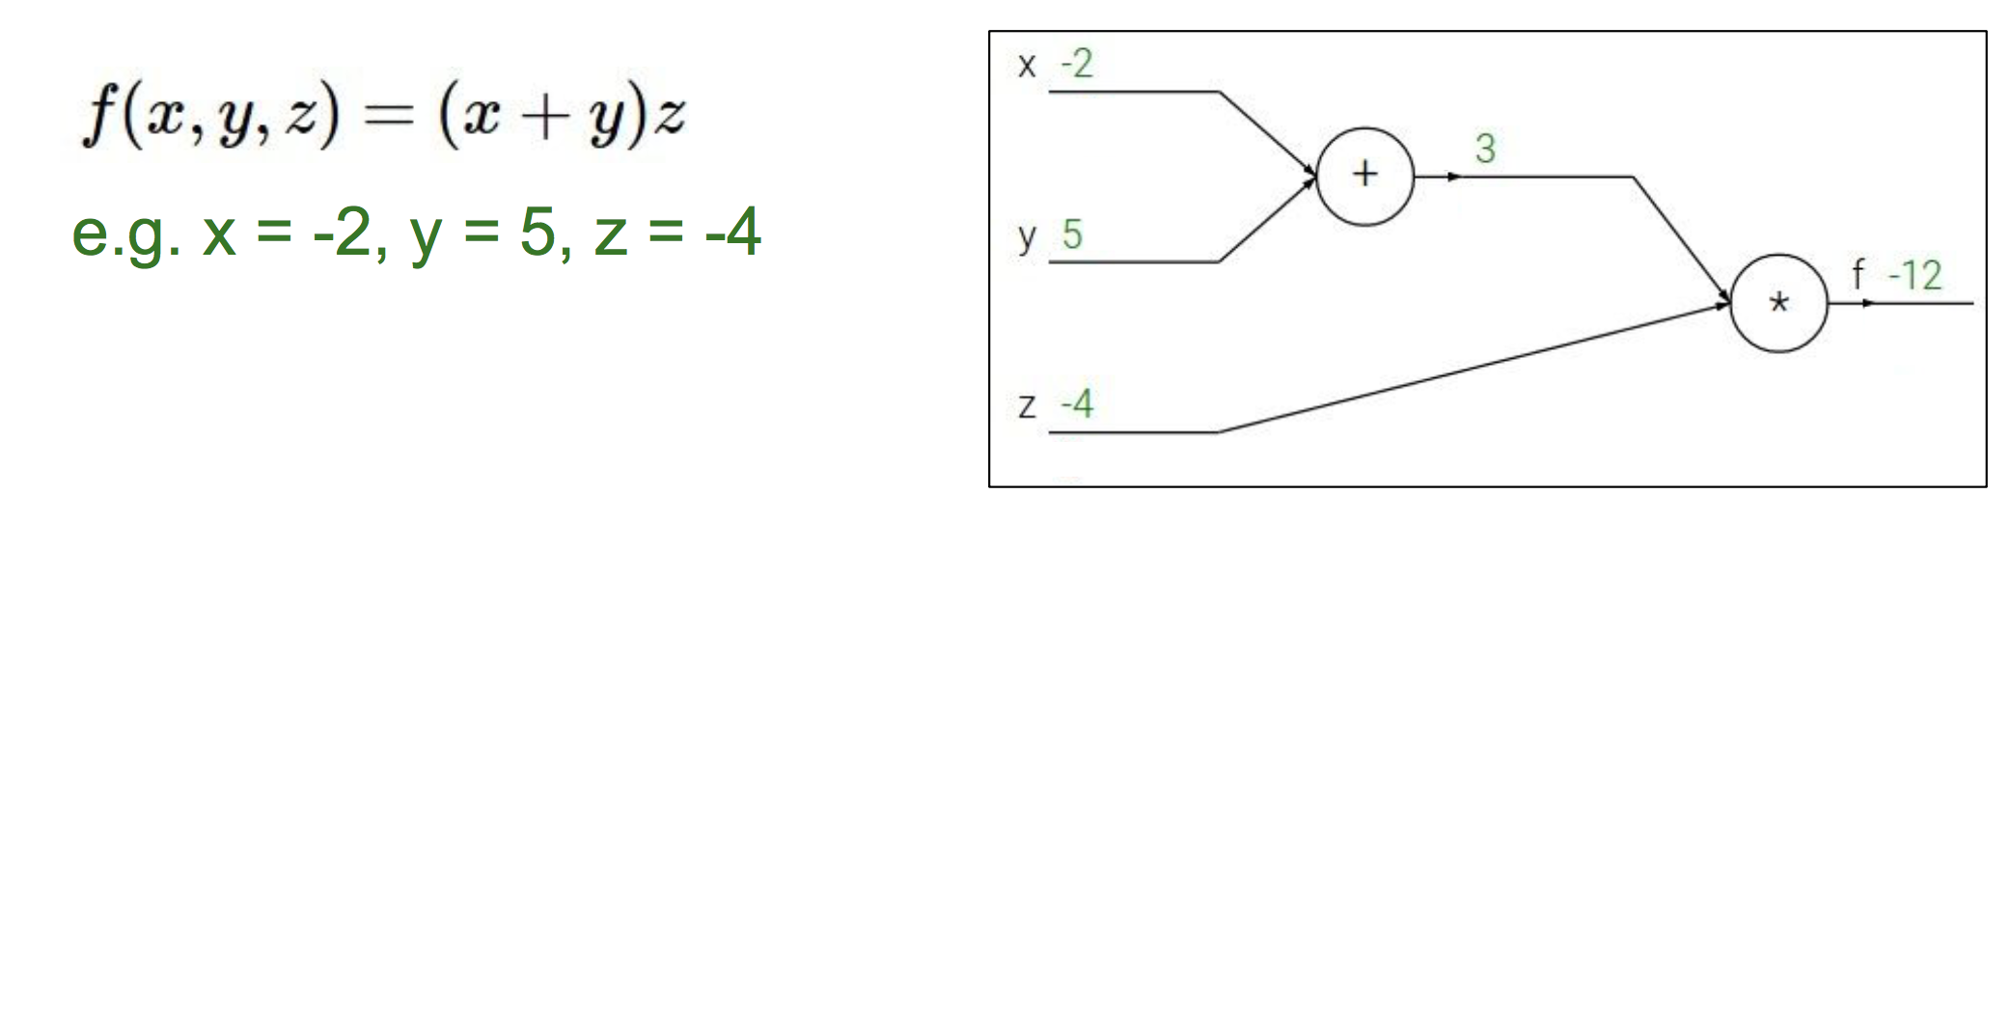
Toy Example
Credit: Fei-Fei Li & Andrej Karpathy & Justin Johnson

Slide 11
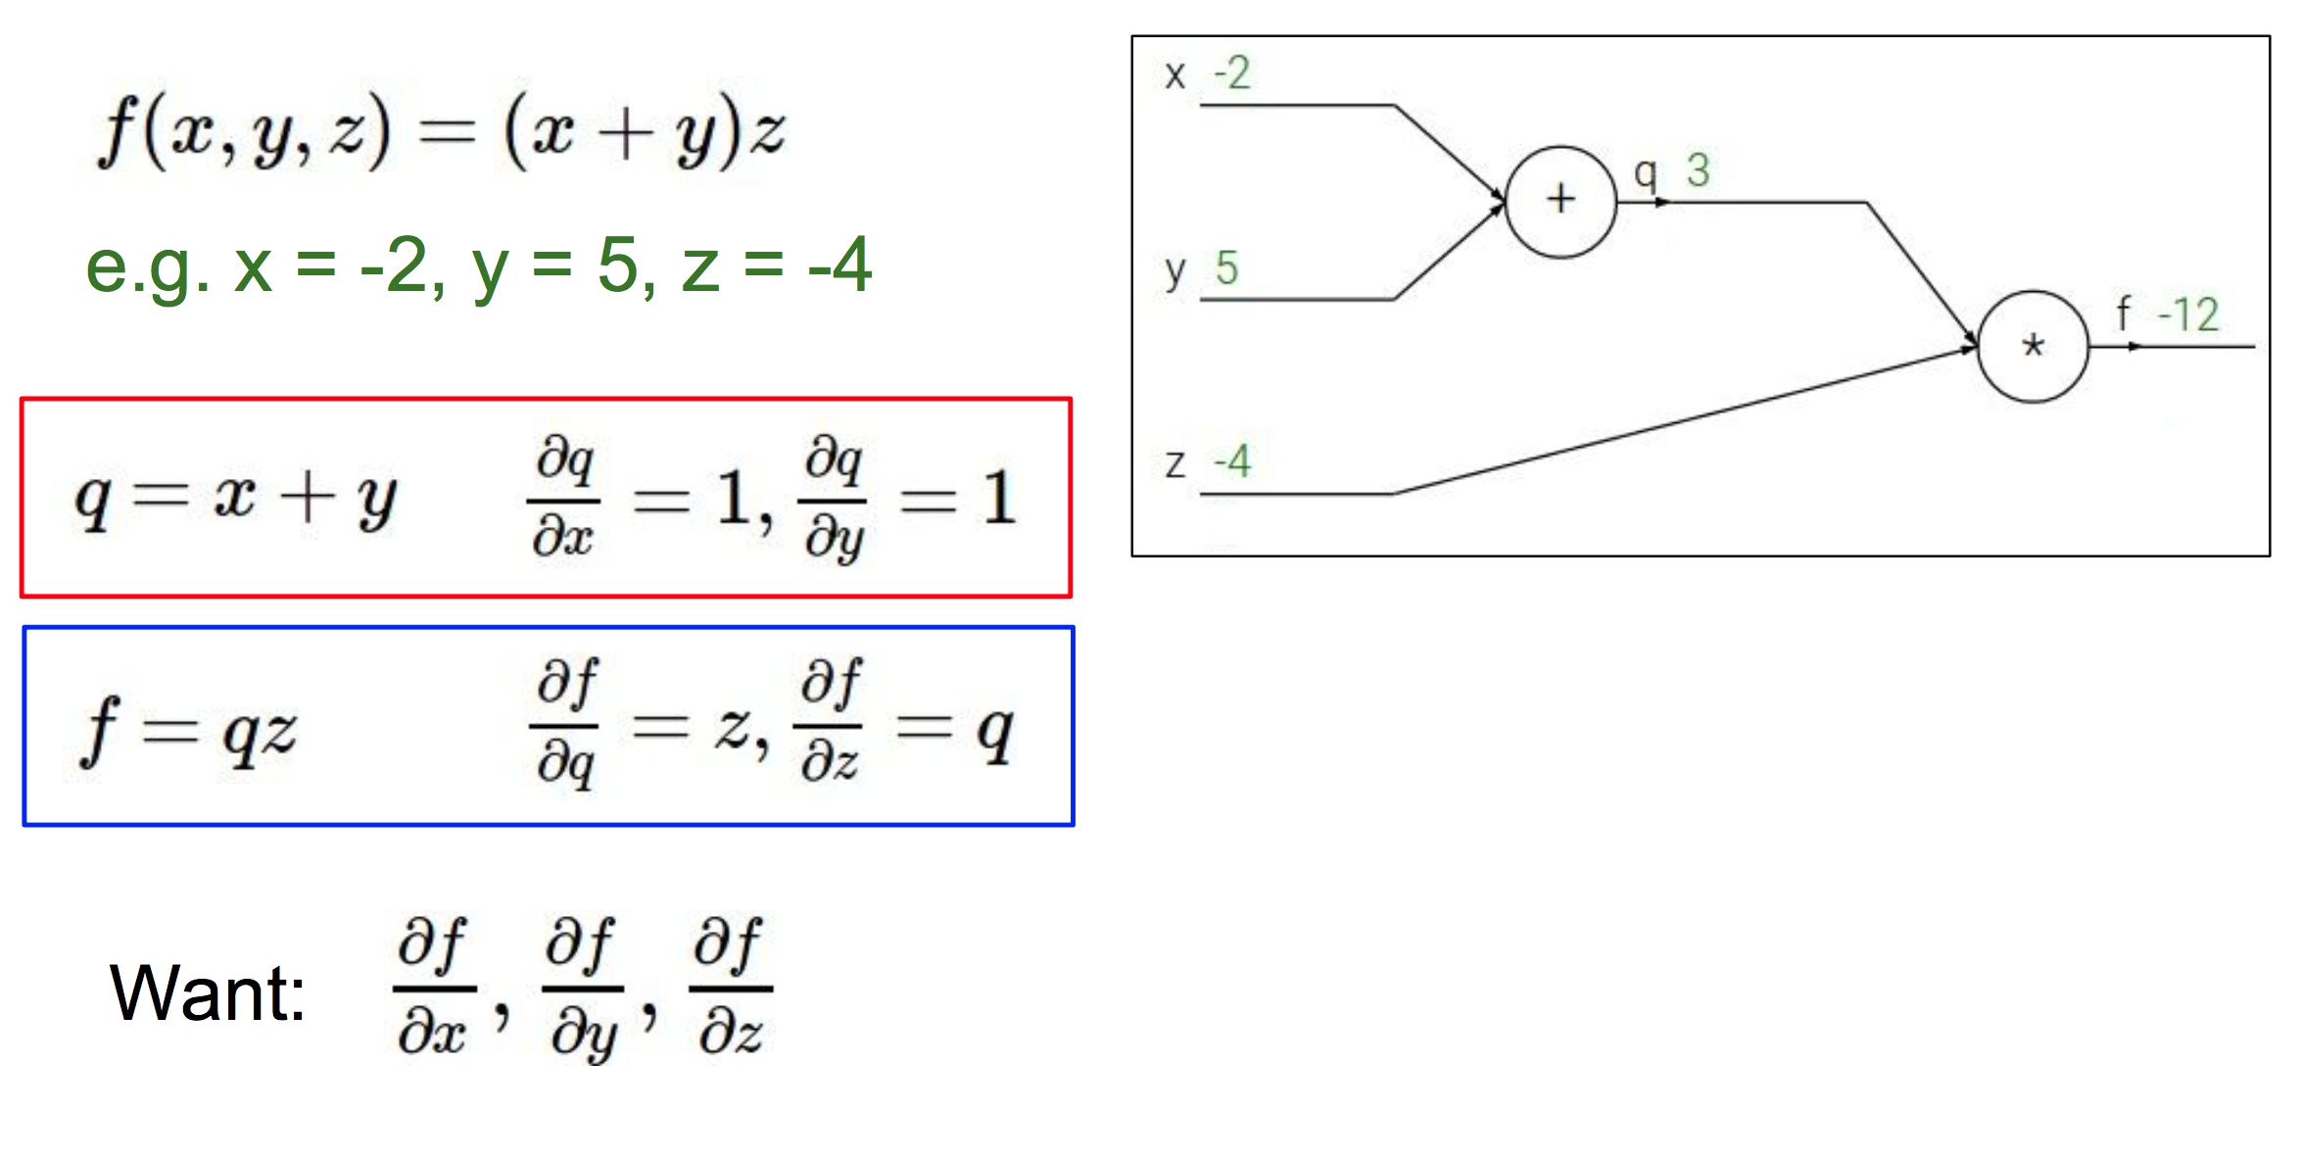
Toy Example
Credit: Fei-Fei Li & Andrej Karpathy & Justin Johnson

Slide 12
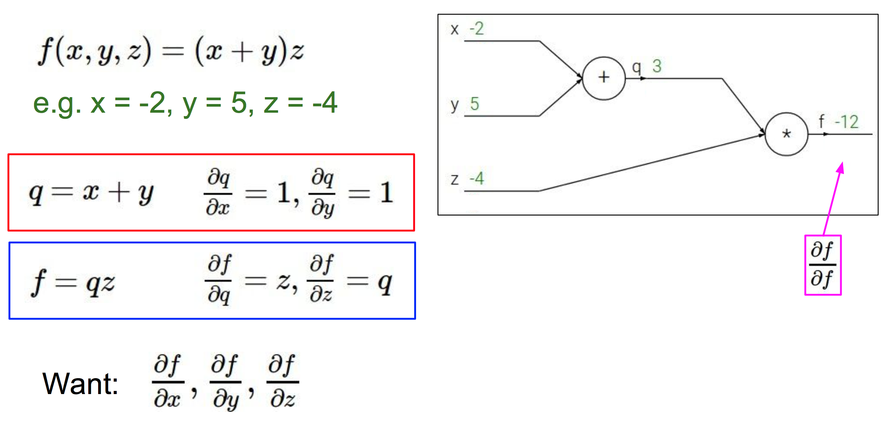
Toy Example
Credit: Fei-Fei Li & Andrej Karpathy & Justin Johnson

Slide 13
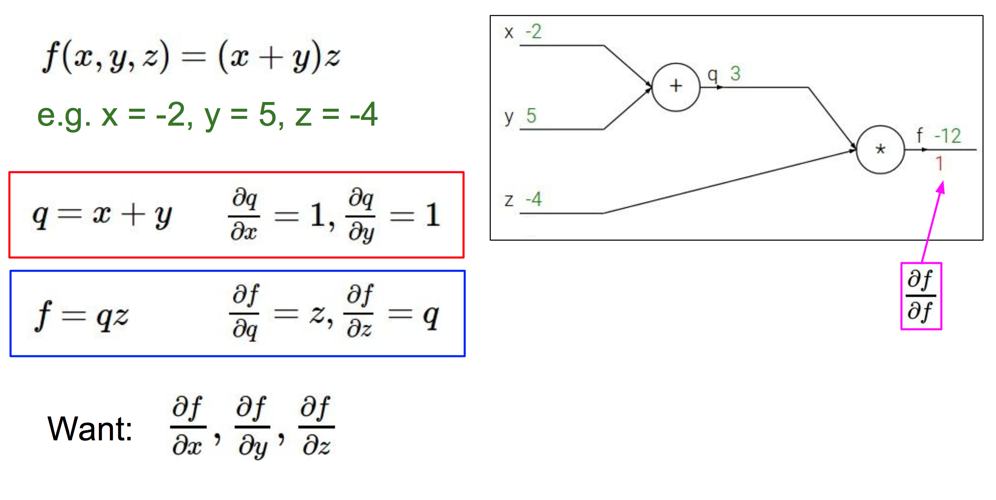
Toy Example
Credit: Fei-Fei Li & Andrej Karpathy & Justin Johnson

Slide 14
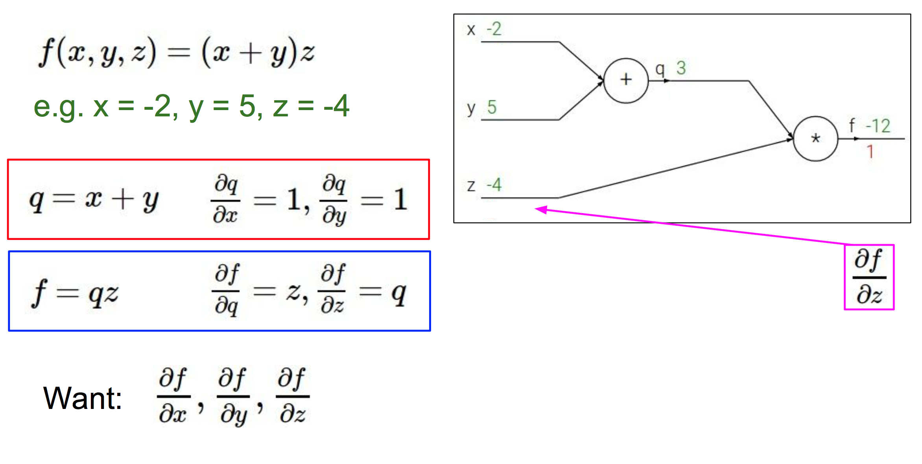
Toy Example
Credit: Fei-Fei Li & Andrej Karpathy & Justin Johnson

Slide 15
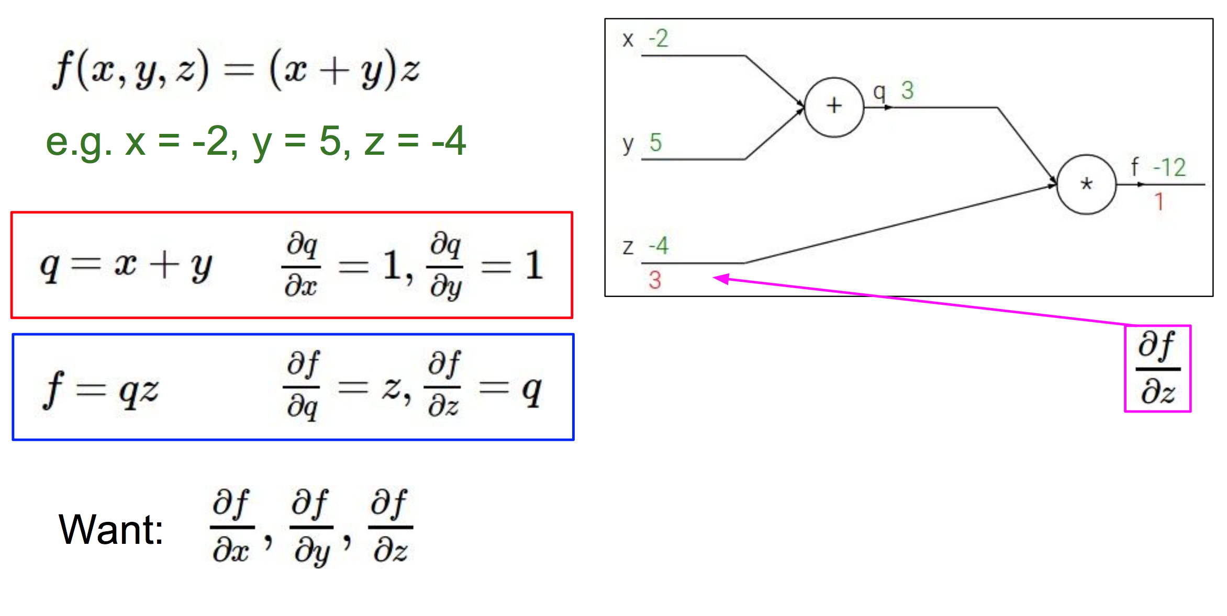
Toy Example
Credit: Fei-Fei Li & Andrej Karpathy & Justin Johnson

Slide 16
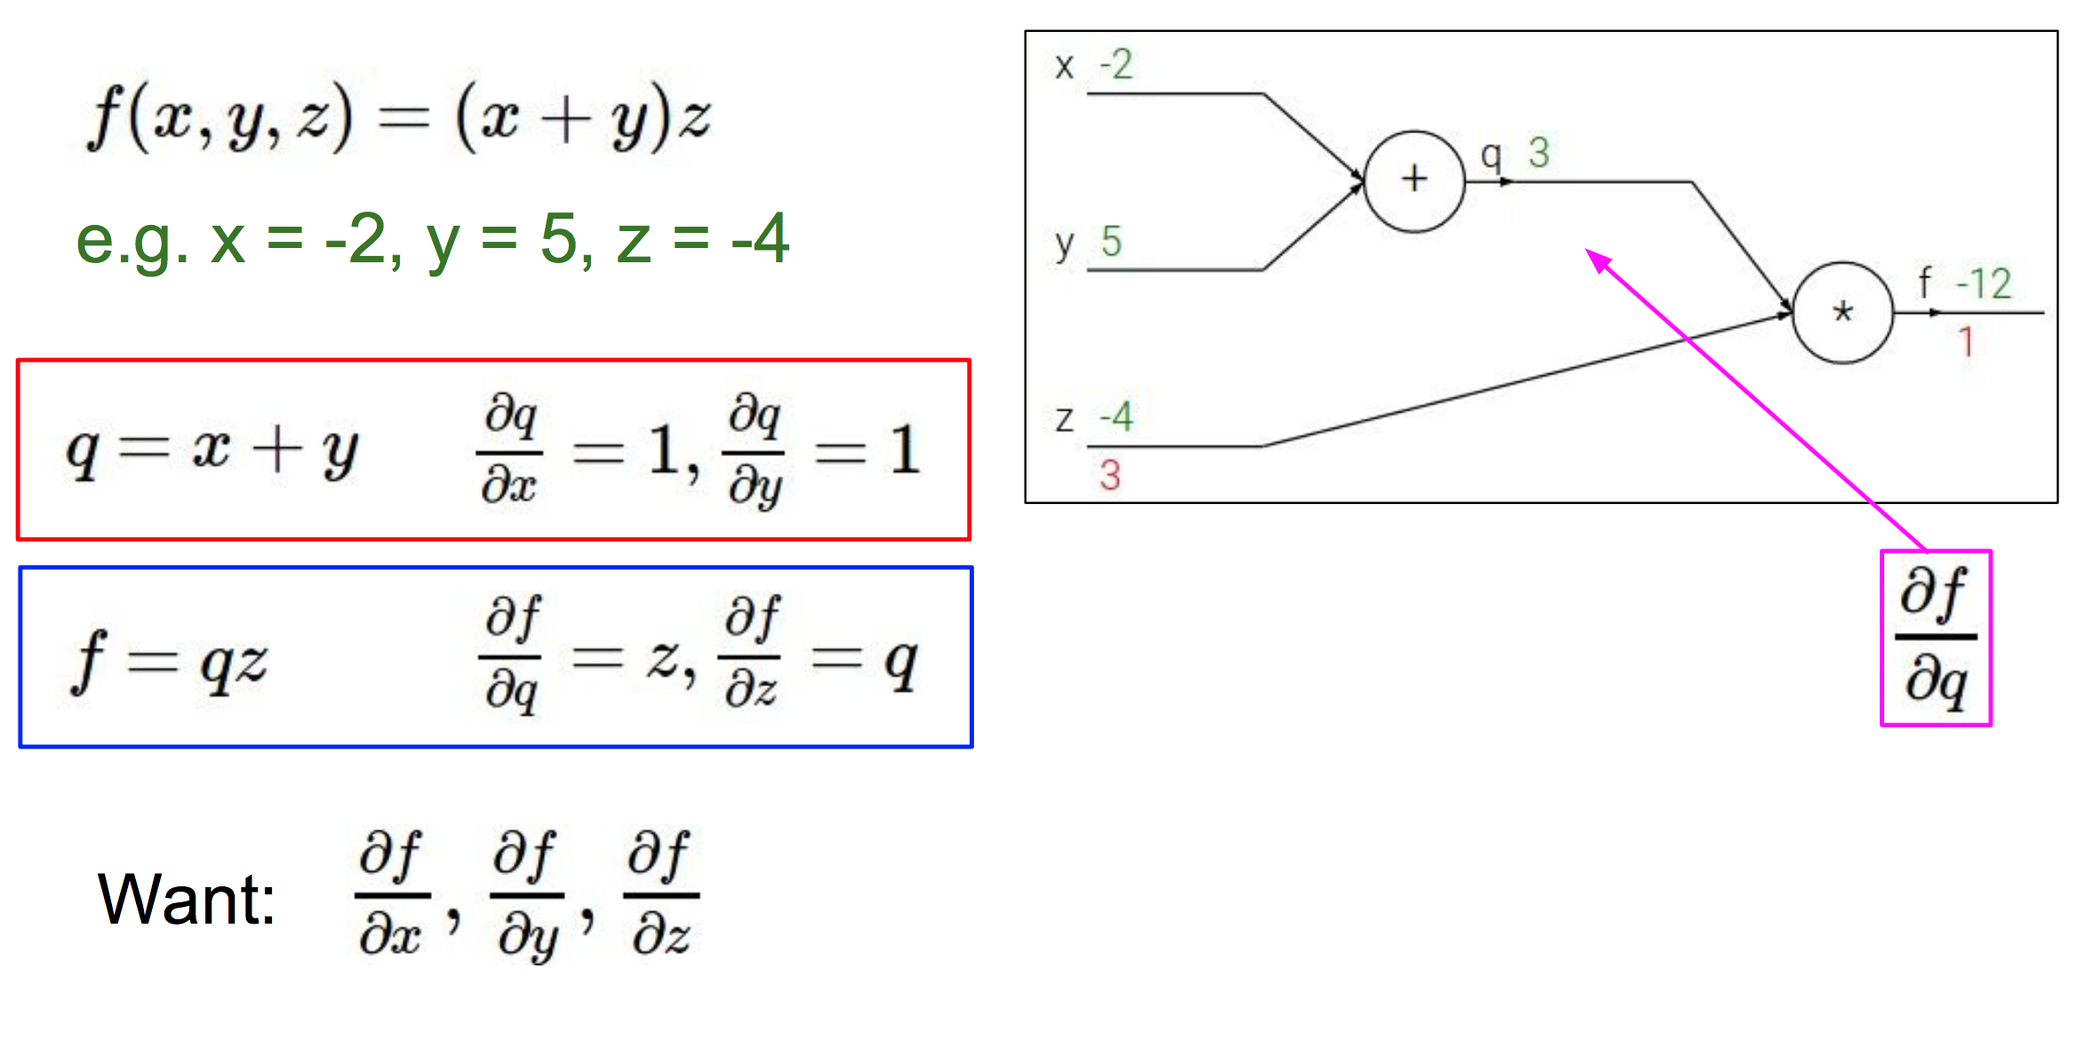
Toy Example
Credit: Fei-Fei Li & Andrej Karpathy & Justin Johnson

Slide 17
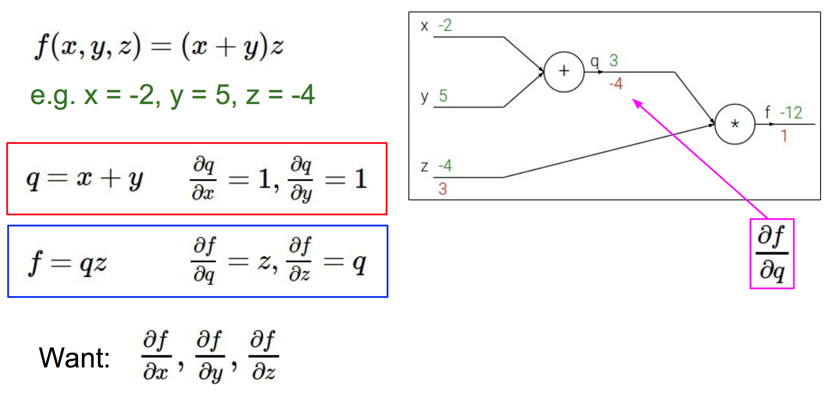
Toy Example
Credit: Fei-Fei Li & Andrej Karpathy & Justin Johnson

Slide 18
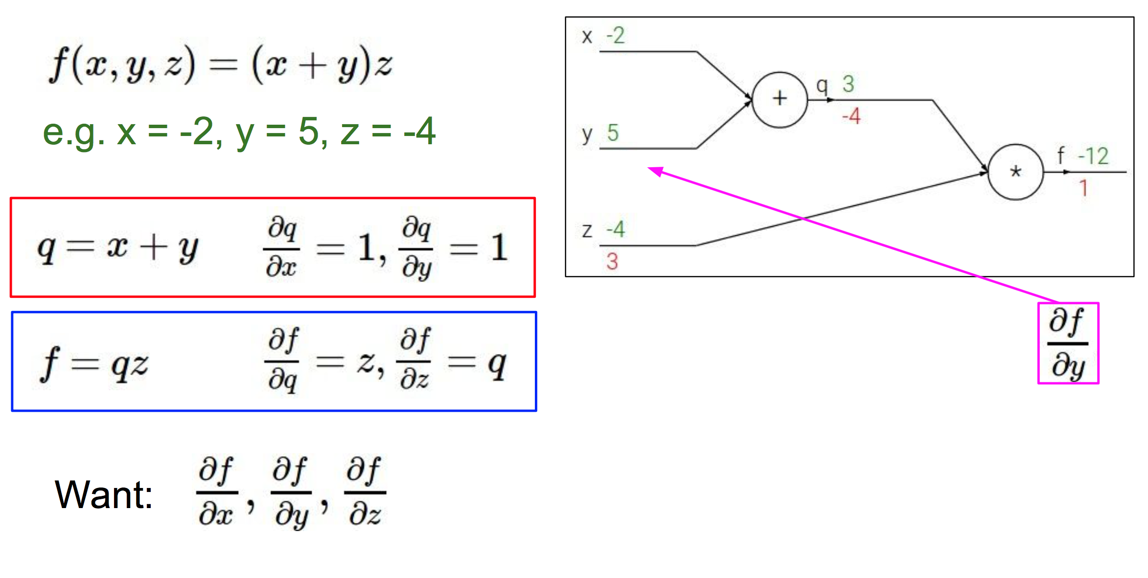
Toy Example
Credit: Fei-Fei Li & Andrej Karpathy & Justin Johnson

Slide 19
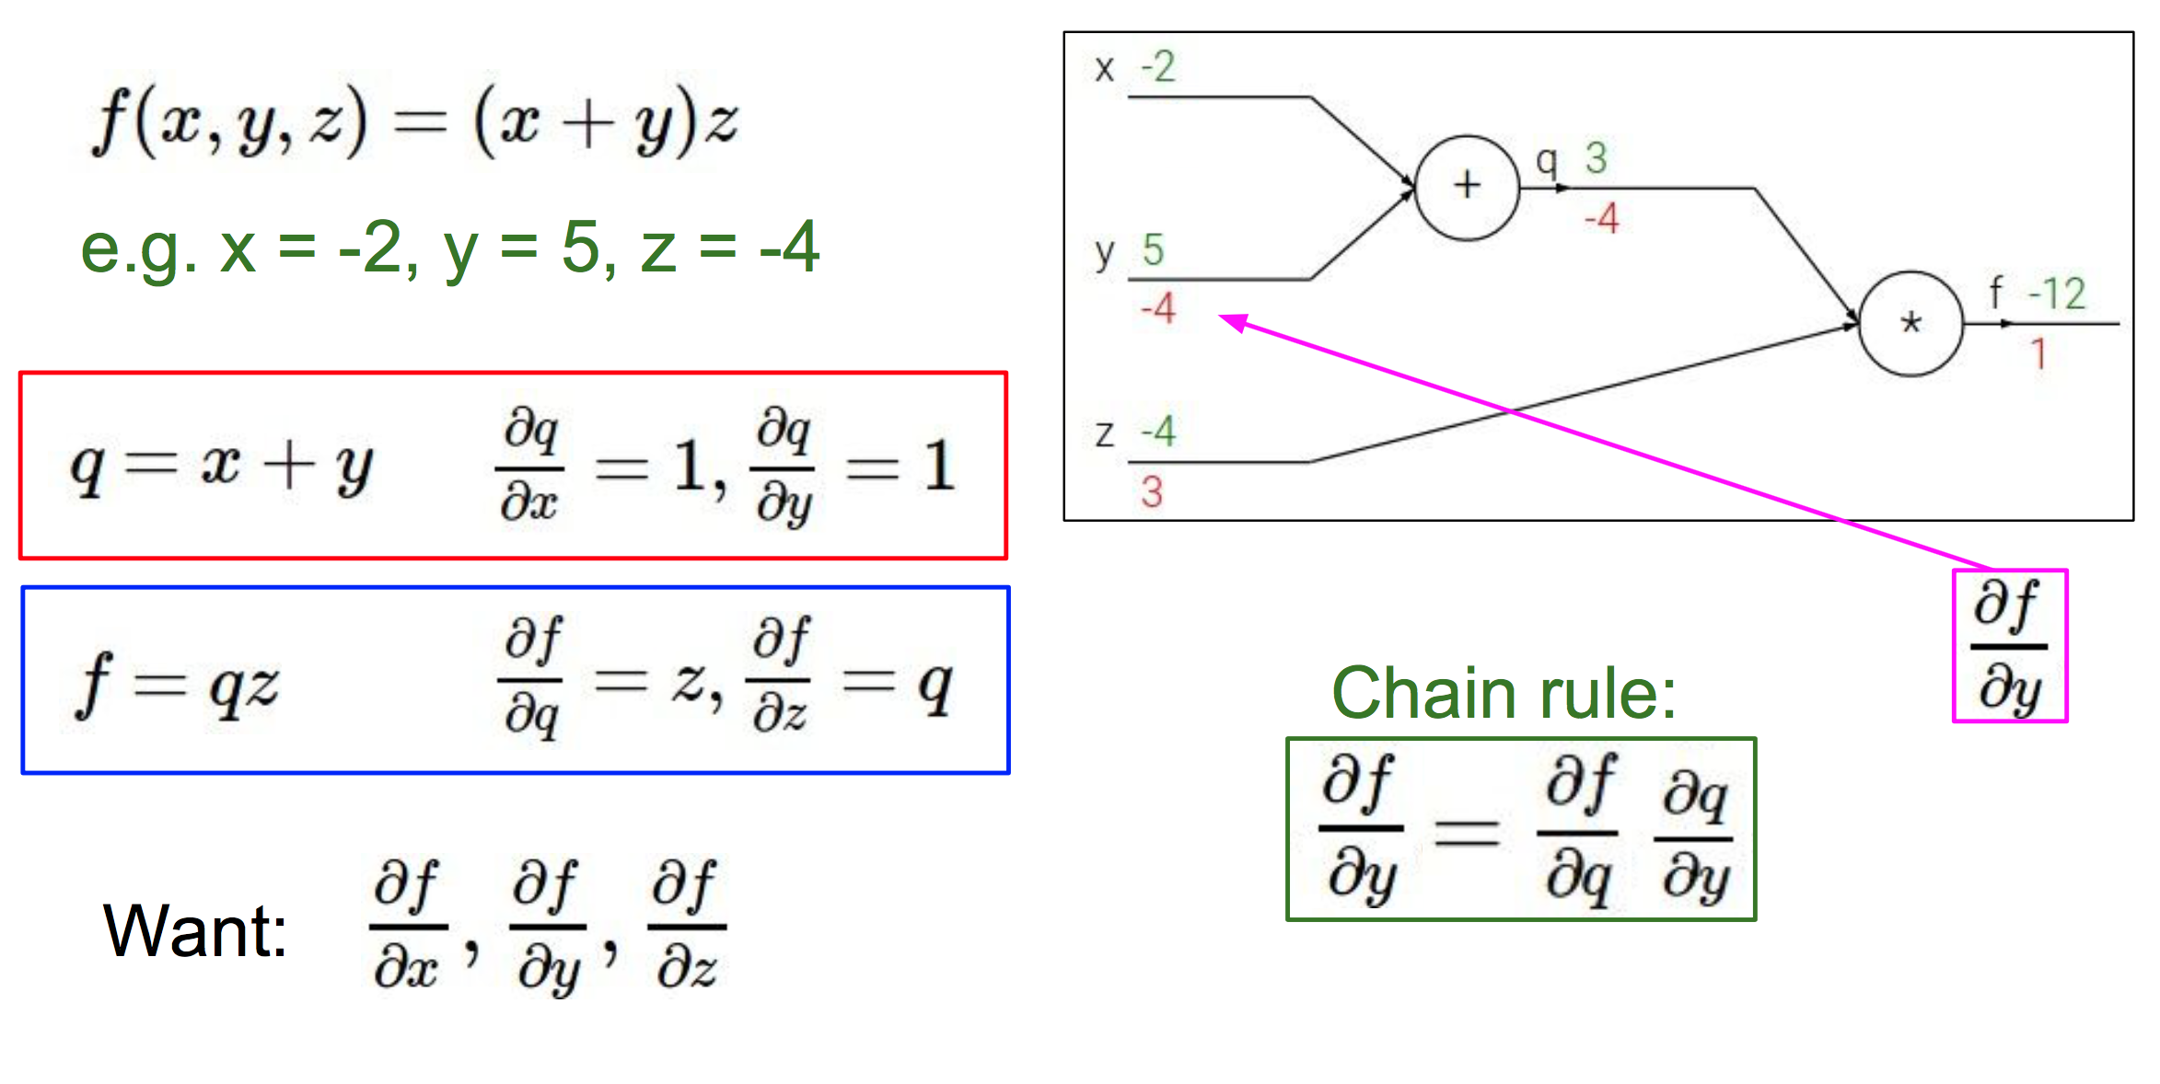
Toy Example
Credit: Fei-Fei Li & Andrej Karpathy & Justin Johnson

Slide 20
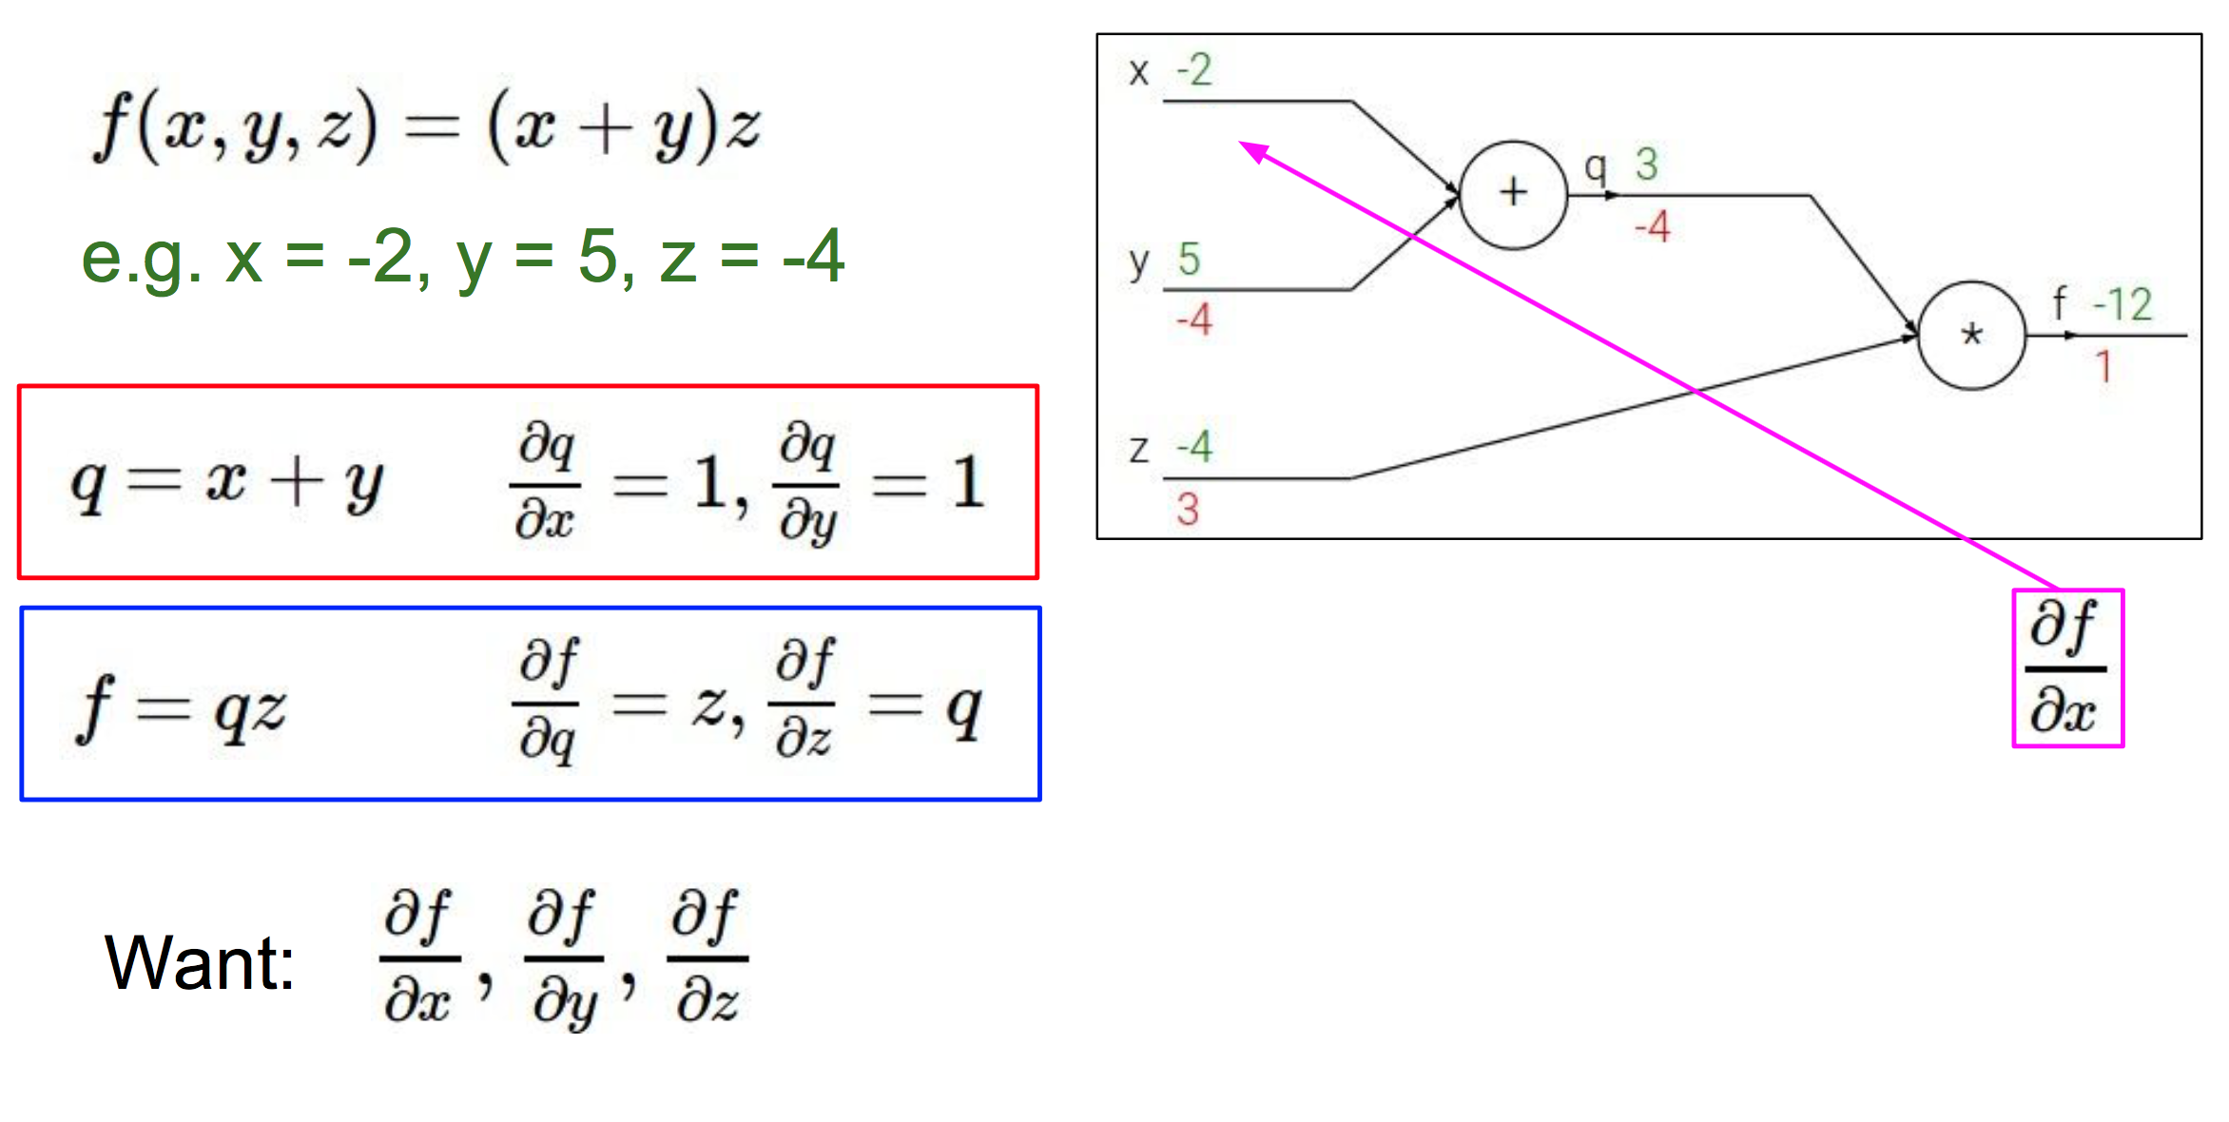
Toy Example
Credit: Fei-Fei Li & Andrej Karpathy & Justin Johnson

Slide 21
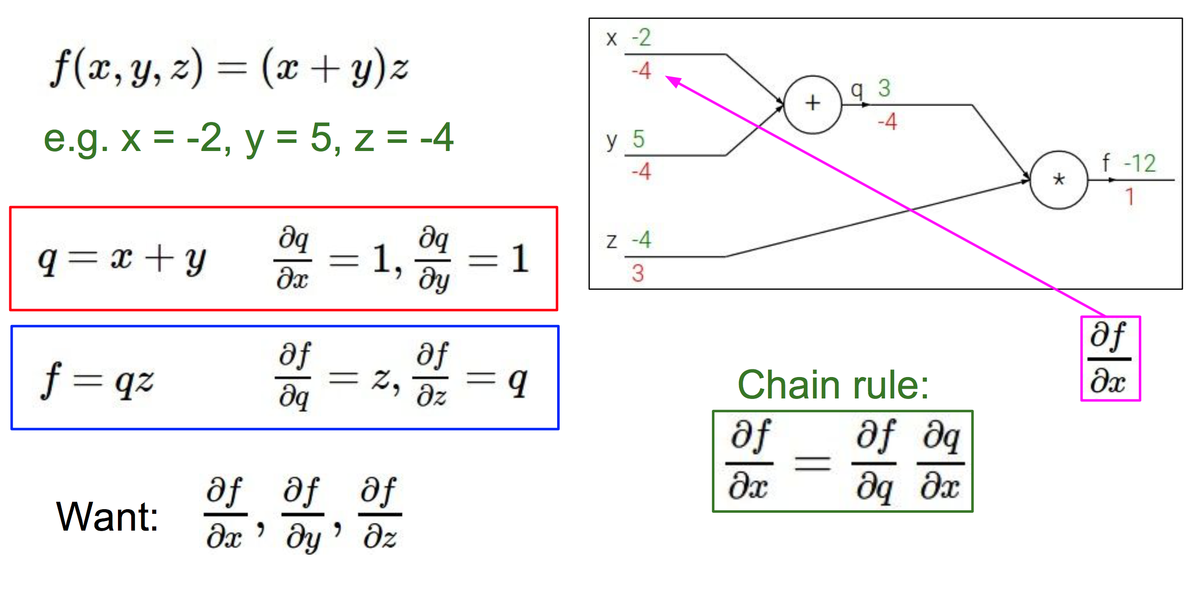
Toy Example
Credit: Fei-Fei Li & Andrej Karpathy & Justin Johnson

Slide 22
Toy Example
Forward pass
Backward pass performs backpropagation
Credit: Fei-Fei Li & Andrej Karpathy & Justin Johnson

Slide 23
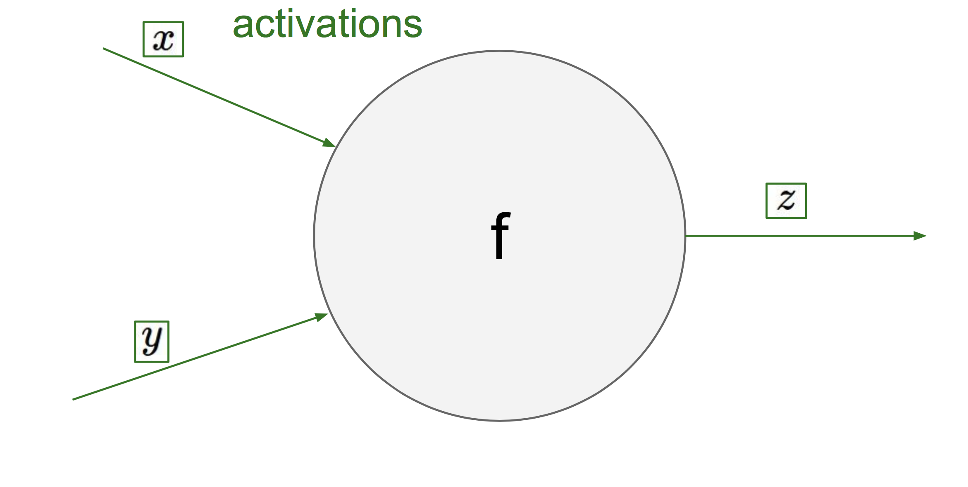
Look at one Neuron…
Credit: Fei-Fei Li & Andrej Karpathy & Justin Johnson

Slide 24
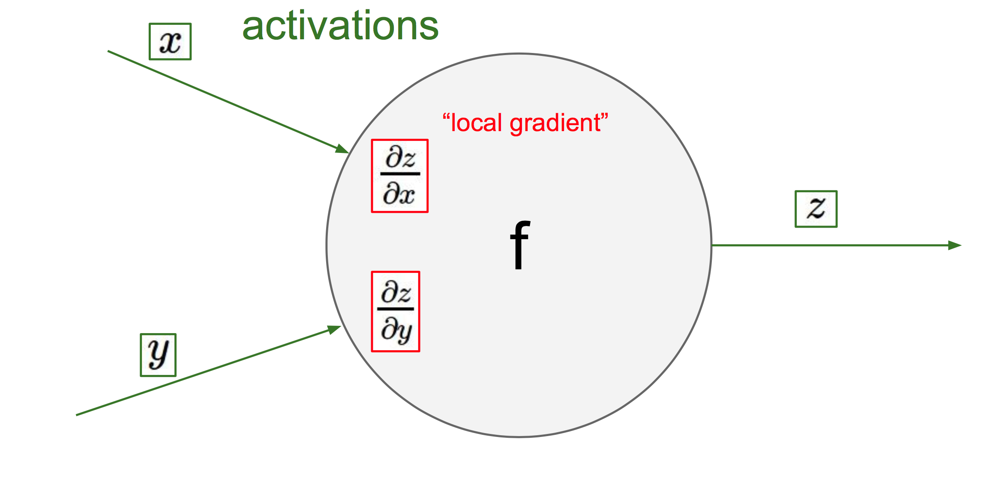
Look at one Neuron…
Credit: Fei-Fei Li & Andrej Karpathy & Justin Johnson

Slide 25
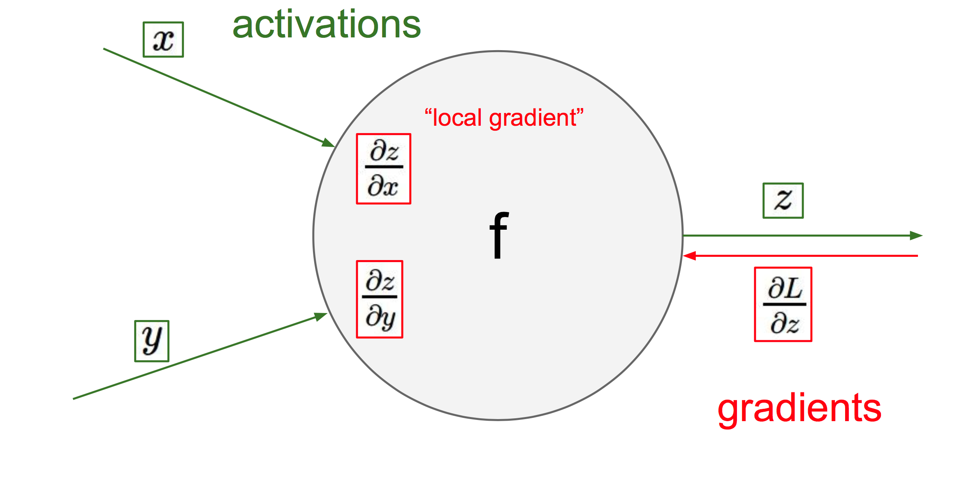
Look at one Neuron…
Credit: Fei-Fei Li & Andrej Karpathy & Justin Johnson

Slide 26
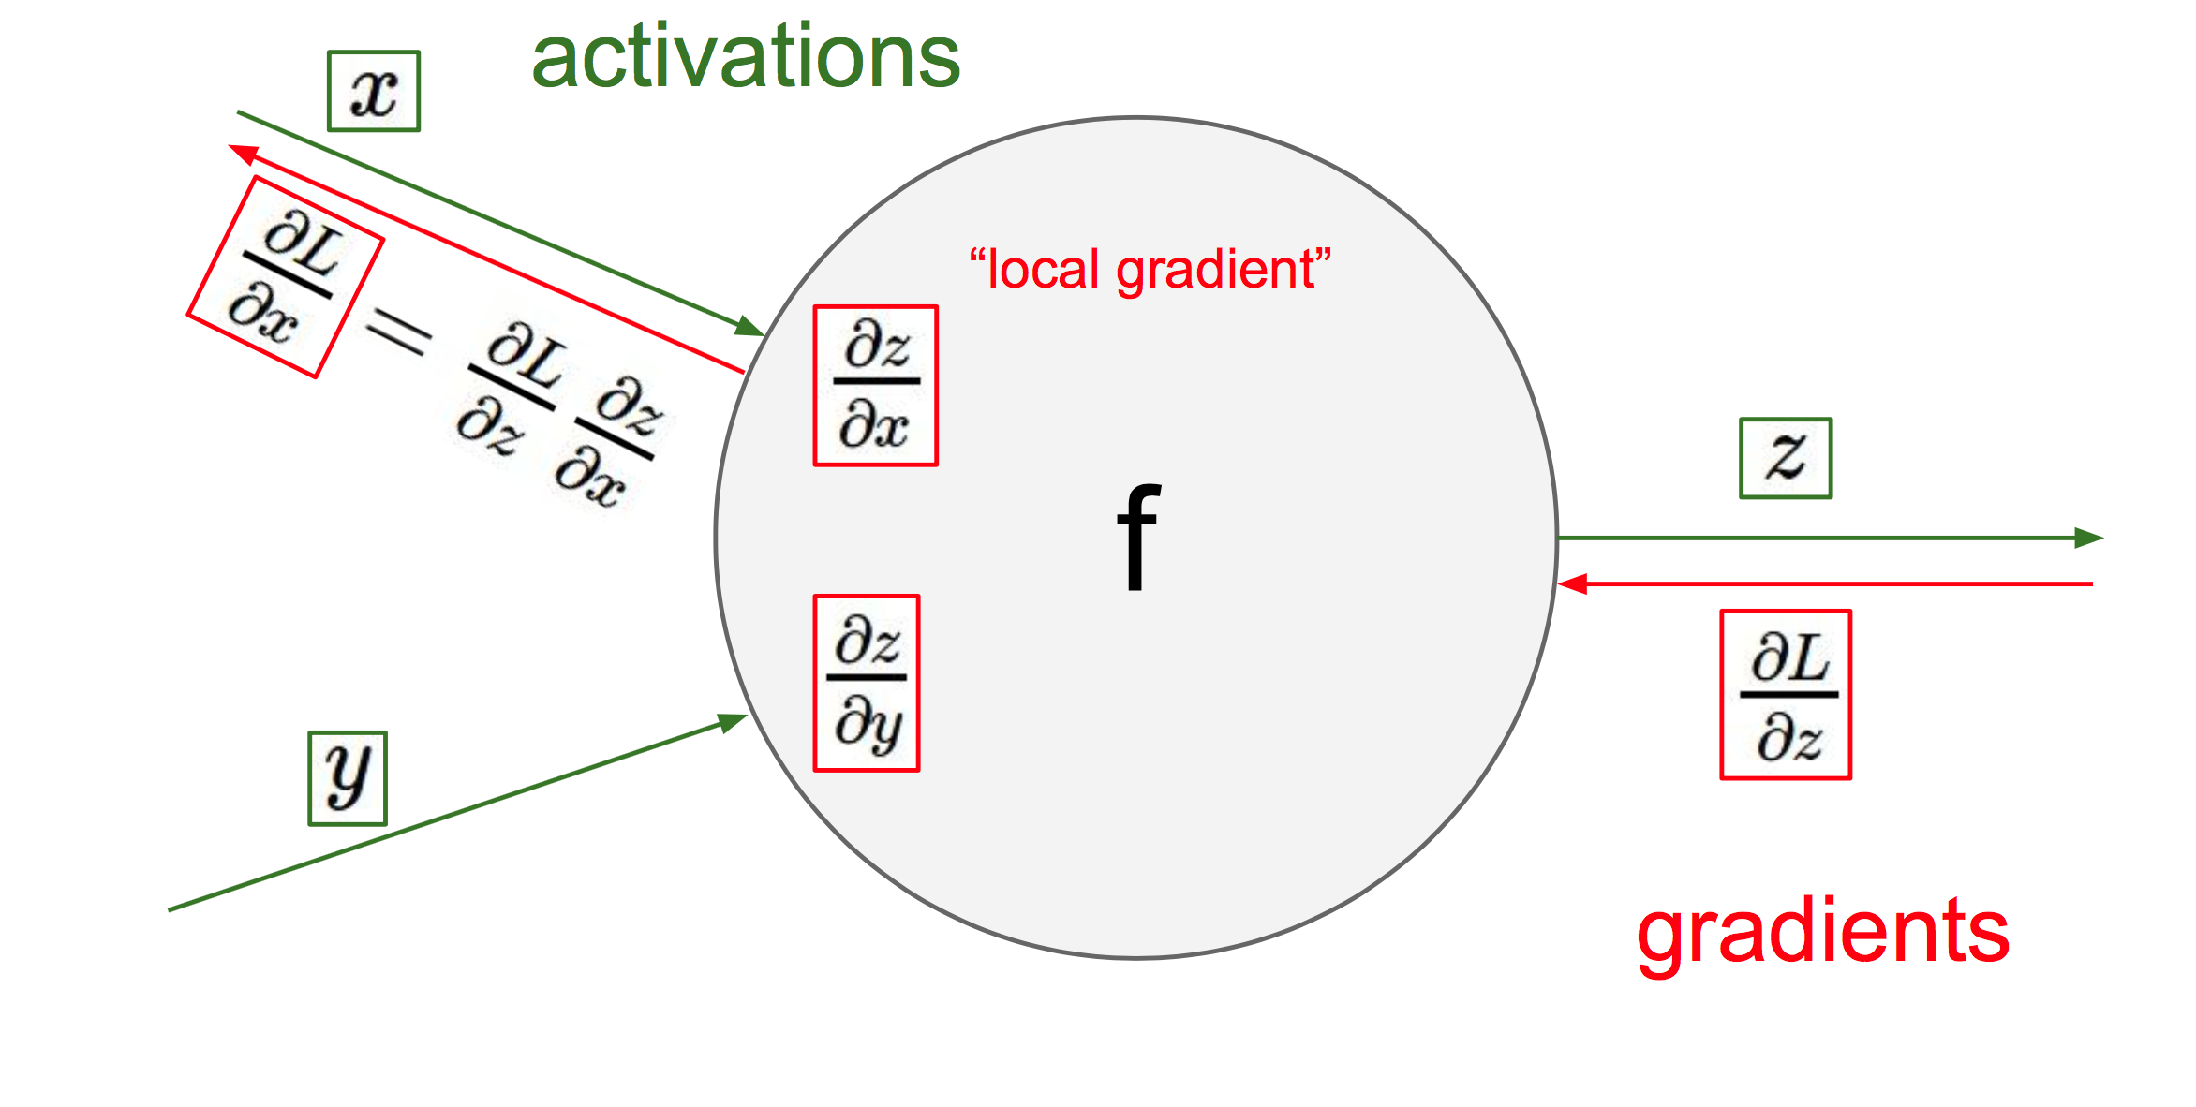
Look at one Neuron…
Credit: Fei-Fei Li & Andrej Karpathy & Justin Johnson

Slide 27
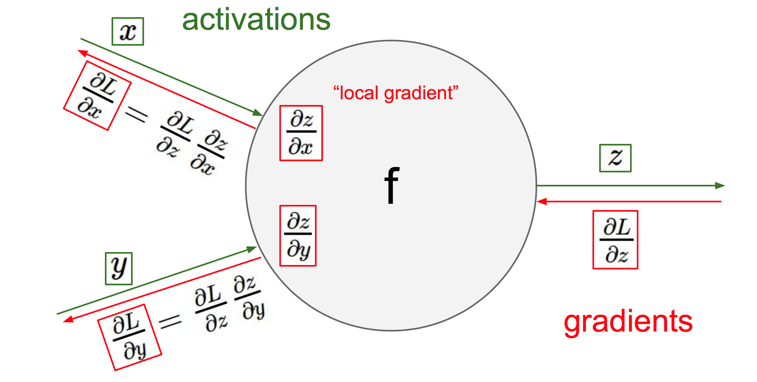
Look at one Neuron…
Credit: Fei-Fei Li & Andrej Karpathy & Justin Johnson

Slide 28
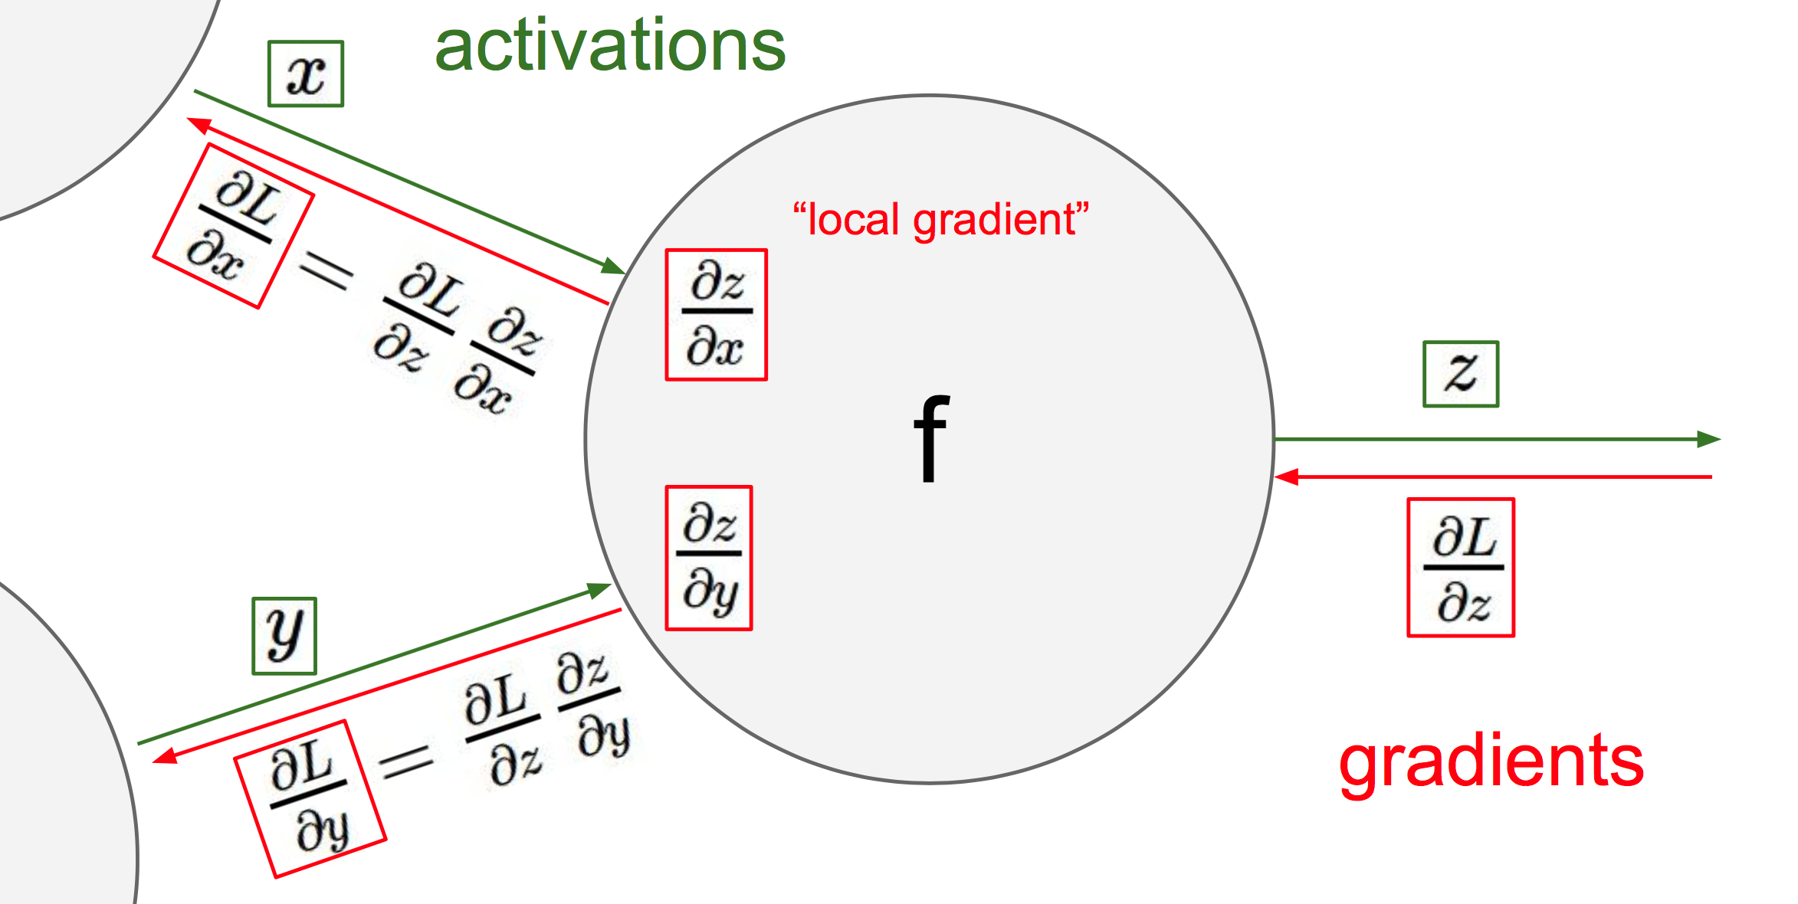
Look at one Neuron…
Credit: Fei-Fei Li & Andrej Karpathy & Justin Johnson

Slide 29
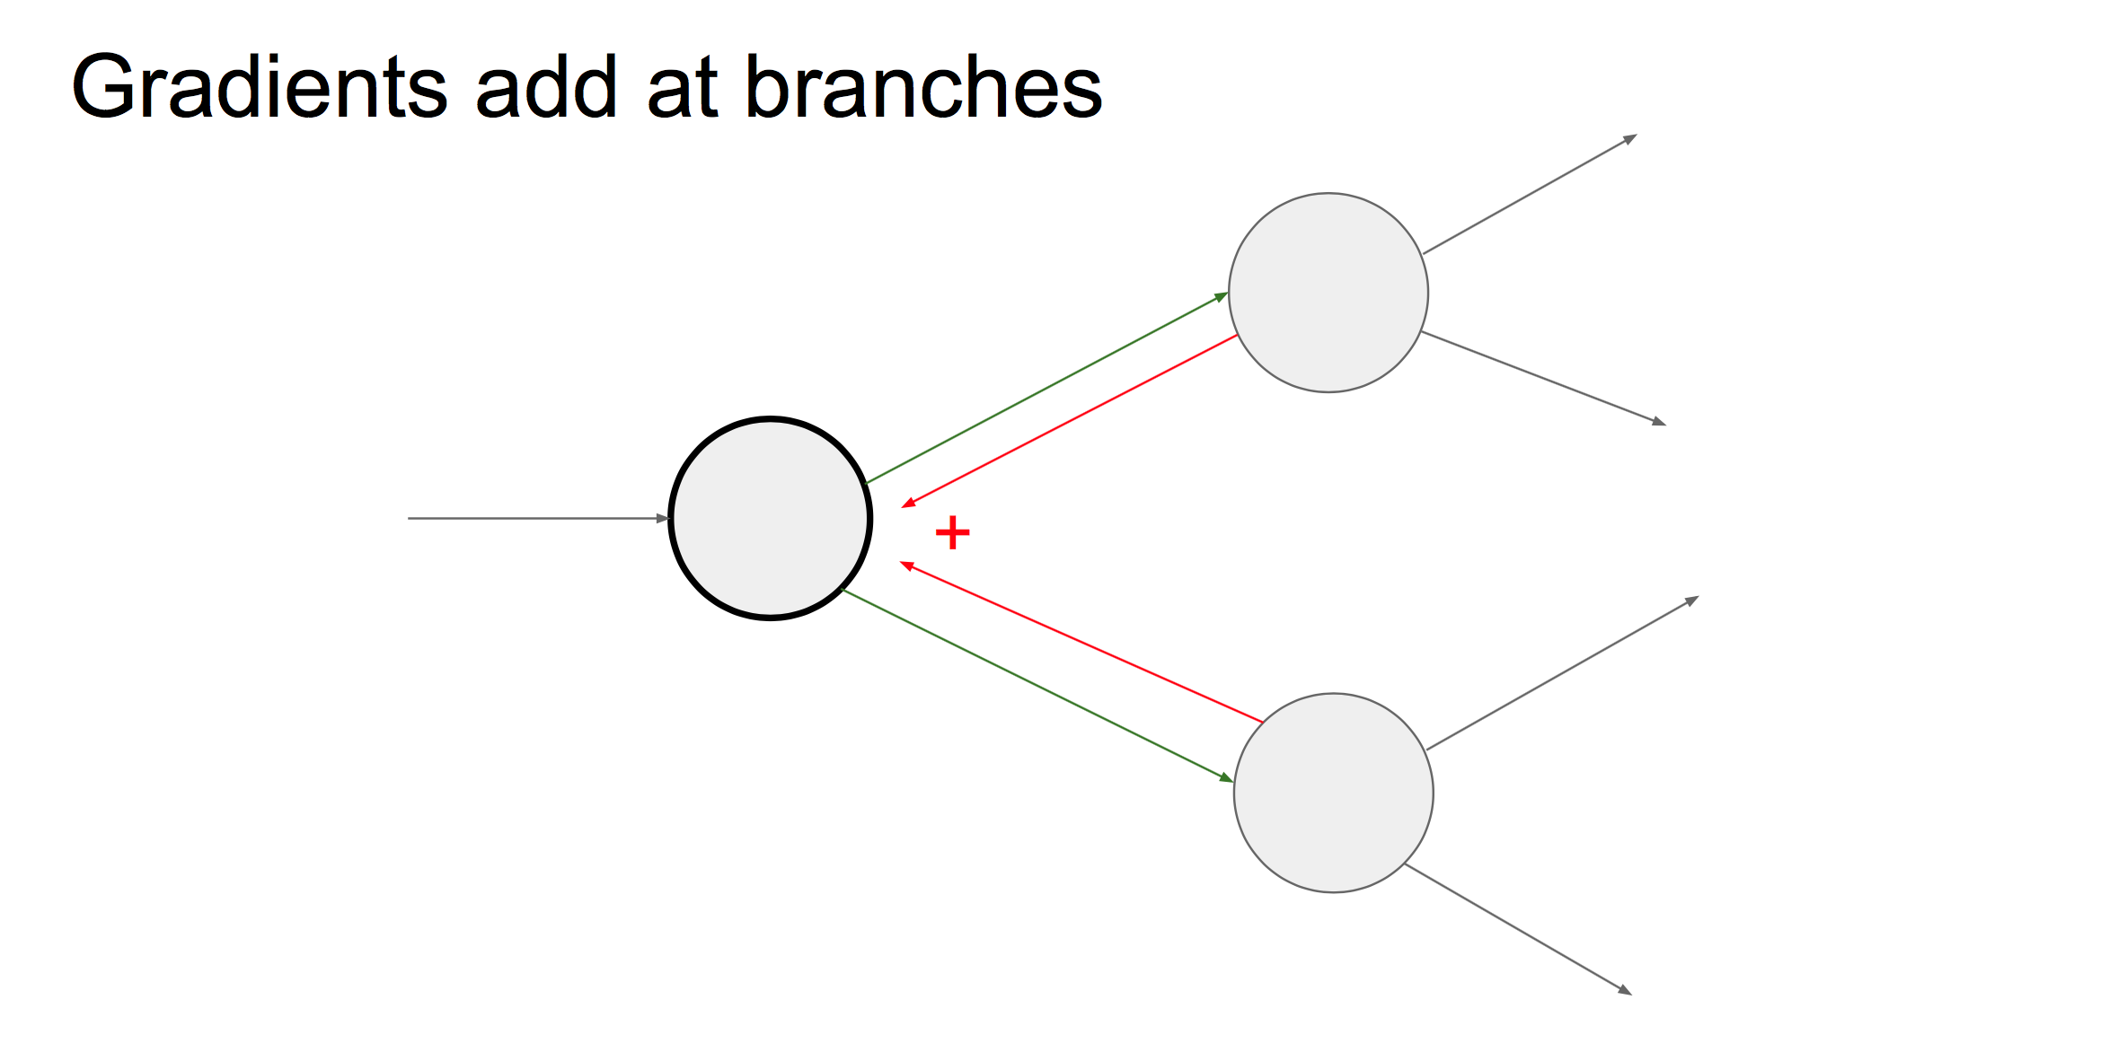
Look at one Neuron…
Credit: Fei-Fei Li & Andrej Karpathy & Justin Johnson

Slide 30
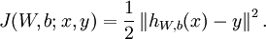
Backpropagation
Suppose we have a fixed training set:
Define the cost function w.r.t. a single example, and suppose we have a (one-half) squared-error cost function.
Other loss functions are possible. Here, we just use it as an example to illustrate BP.
In your homework, we will ask you to implement others.

Slide 31
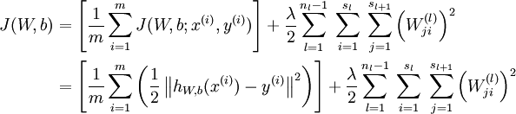
Backpropagation
Given a training set of m example, we can define the overall cost function to be:
Batch Error
Weight Decay
Weight decay parameter that balances the two terms

Slide 32
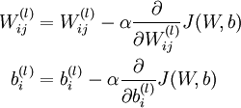
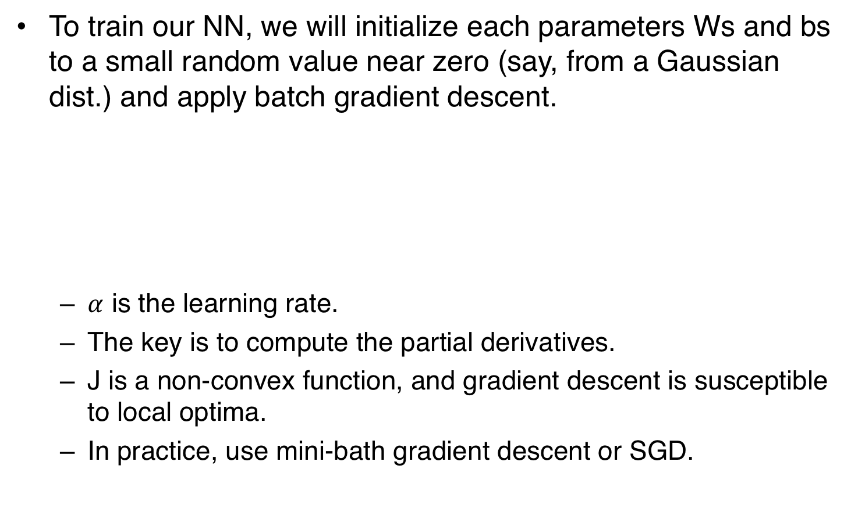
Backpropagation
To train our NN, we will initialize each parameters Ws and bs to a small random value near zero (say, from a Gaussian dist.) and apply batch gradient descent.
$α$ is the learning rate.
The key is to compute the partial derivatives.
J is a non-convex function, and gradient descent is susceptible to local optima.
In practice, use mini-bath gradient descent or SGD.

Slide 33
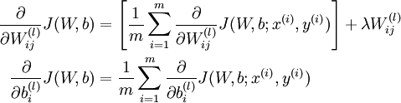
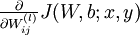
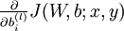
Backpropagation
Let’s take a close look at the partials.
Next, we will see how BP is used to compute:

Slide 34
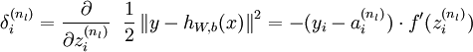
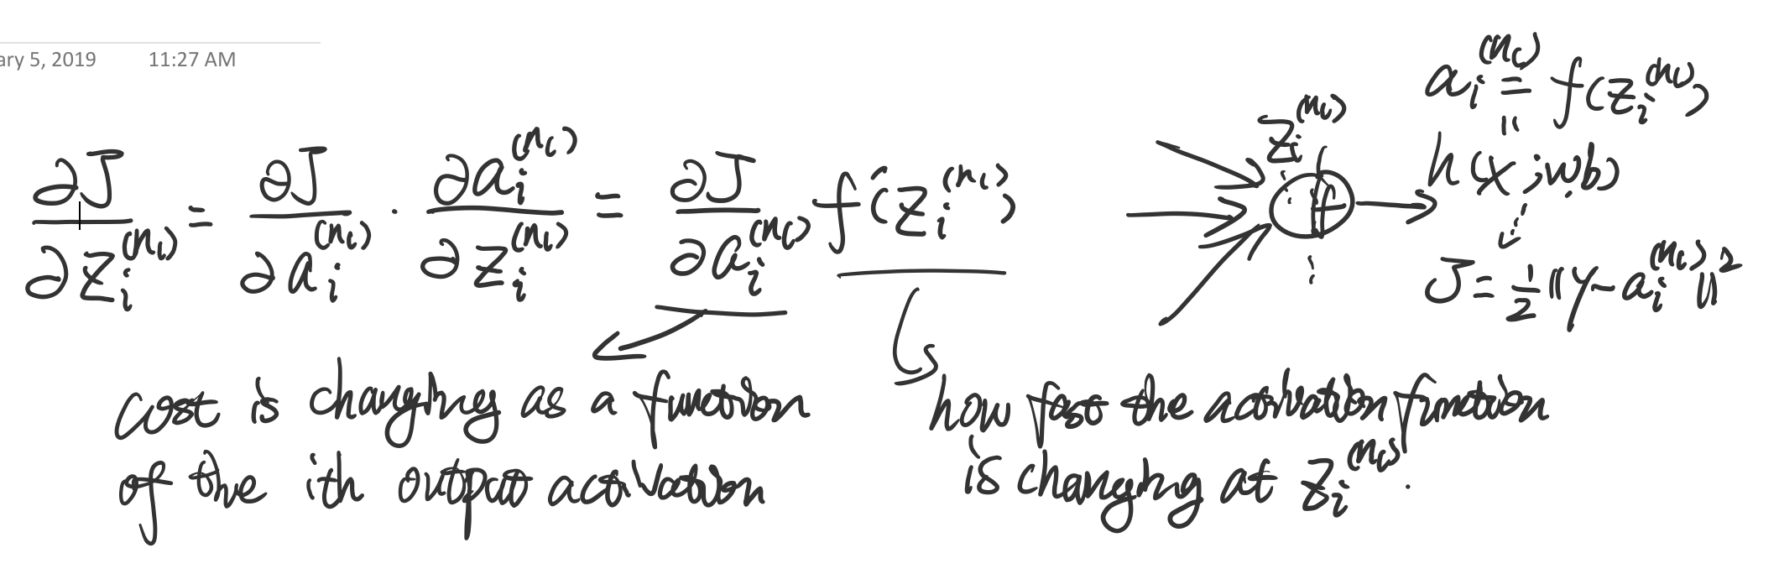
Backpropagation
1. Perform a feedforward pass, computing the activations for layers L2, L3, and so on up to the output layer L(nl).
2. For each output unit i in layer nl (the output layer), set:

Slide 35
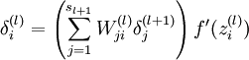
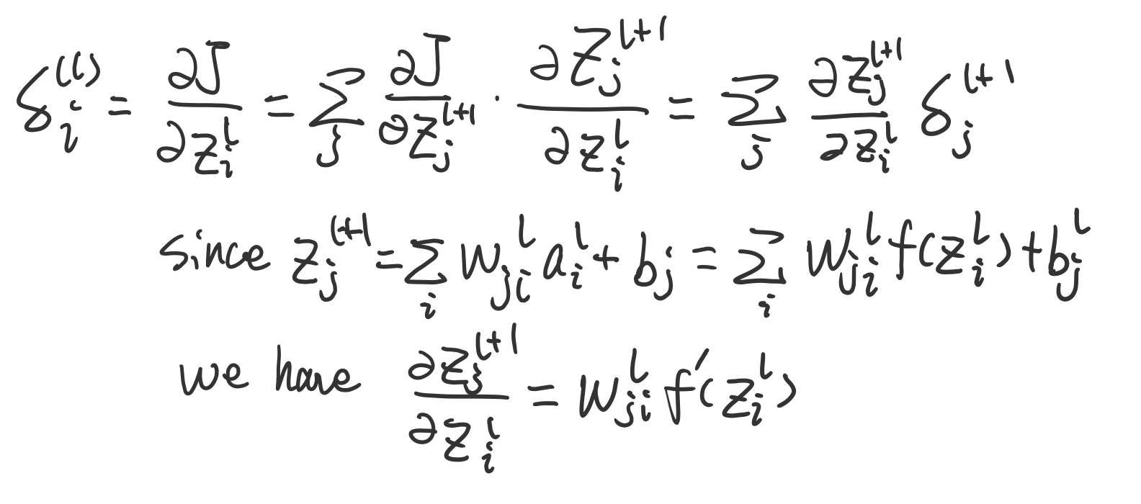
Backpropagation
3. For l = nl-1, nl-2, nl-3, …, 2
For each node i in layer l, set:

Slide 36
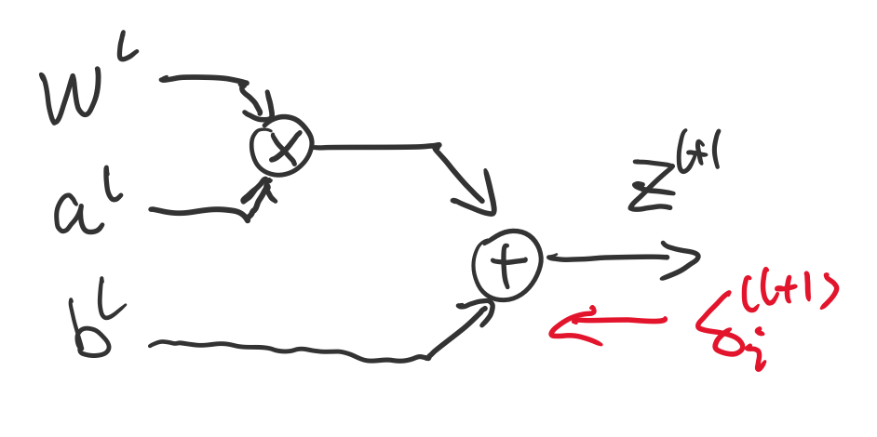
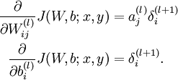
Backpropagation
4. Compute the goal partials:
Done with one sample!
You could also write it using matrix-vectorial notation.
Compute all samples and do an update for Batch GD.

Slide 37
Summary
Additional readings:
http://ufldl.stanford.edu/wiki/index.php/UFLDL_Tutorial

